Slide 1
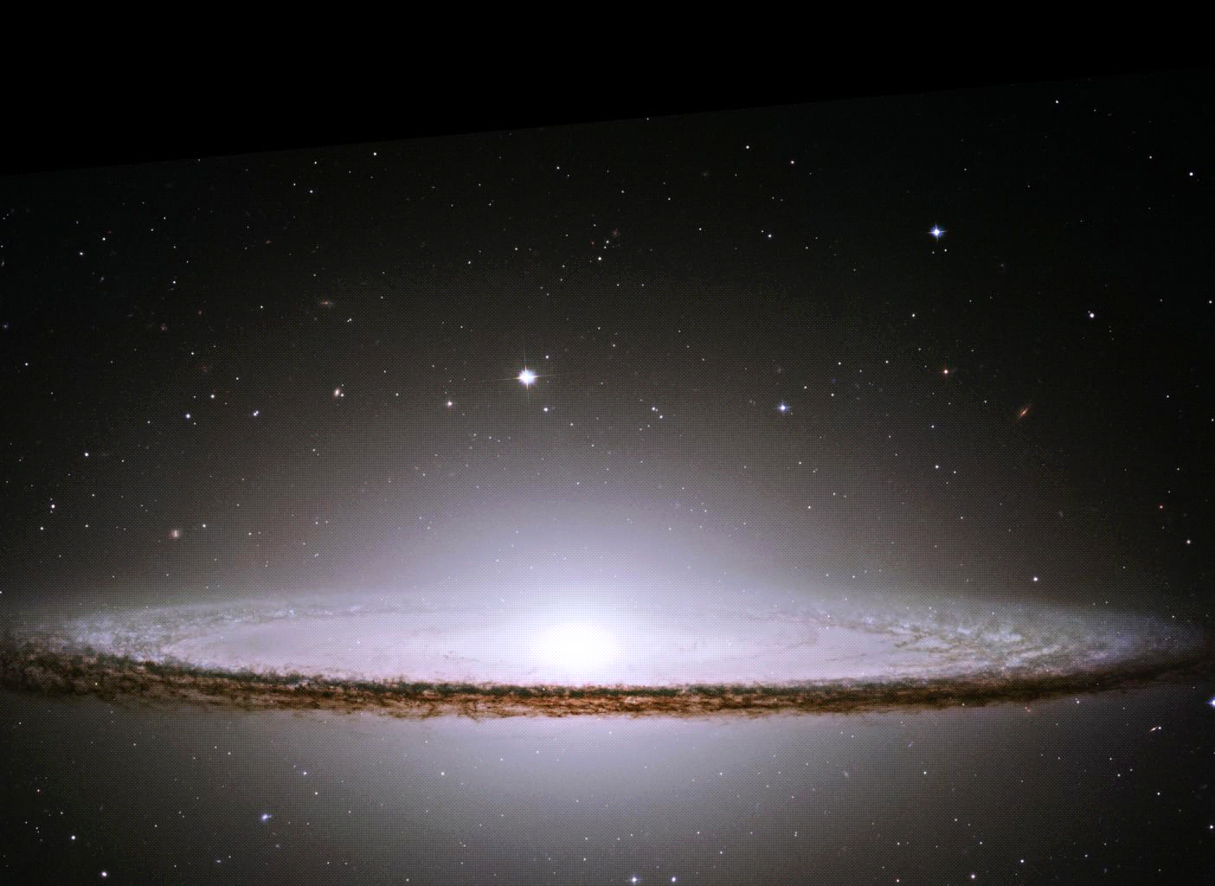
Hello…Is anyone out there?
Выполнила:
Учитель английского языка
Вахидова Д. Ф.
МОУ «СОШ № 21»
г. Оренбург, 2017 год.

Slide 2
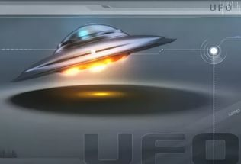
A UFO and space technology
(НЛО и космические технологии)
A UFO is an Unidentified Flying Object (неопознанный летающий объект)

Slide 3
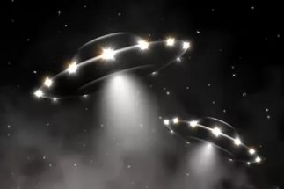
A UFO has been identified as a possible or actual alien spacecraft.
Such objects include meteors, disintegrating satellites, flocks of birds, aircraft, lights, weather balloons, and just about anything moving within the visible band of electromagnetism.

Slide 4
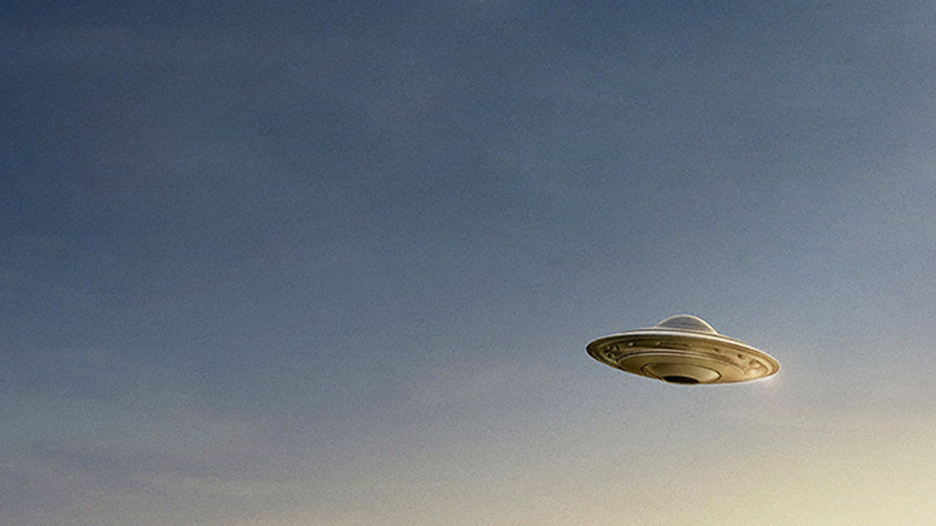
1.All the _____ in our_________ are 4.5 billion years old.
2.Jupiter has 63 _____.The largest, Ganymede, is bigger than Mercury.
3.The stars in the Milky Way, the ______ to which the sun belong, number in hundreds of billions.
4.The gas tail of a _____ always points away from the sun.
5.The first communications______ orbited the earth every 2 hours and 37 minutes.
№1
Complete the sentences with:
planets
moons
comet
galaxy
solar system
satellite

Slide 5
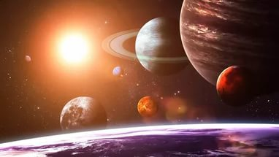
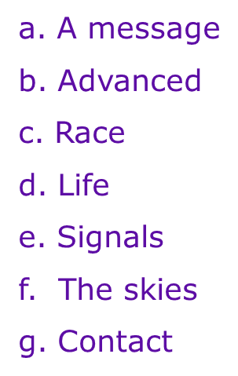
Read the text at p. 102-103 and do this task
(Match the words to from collocations ,then use the phrases in sentences of your own)
1.Establish
2.Extra-terrestrial
3.Sweep
4.Send communication
5.Technologically
6.Human
7.Broadcast

Slide 6
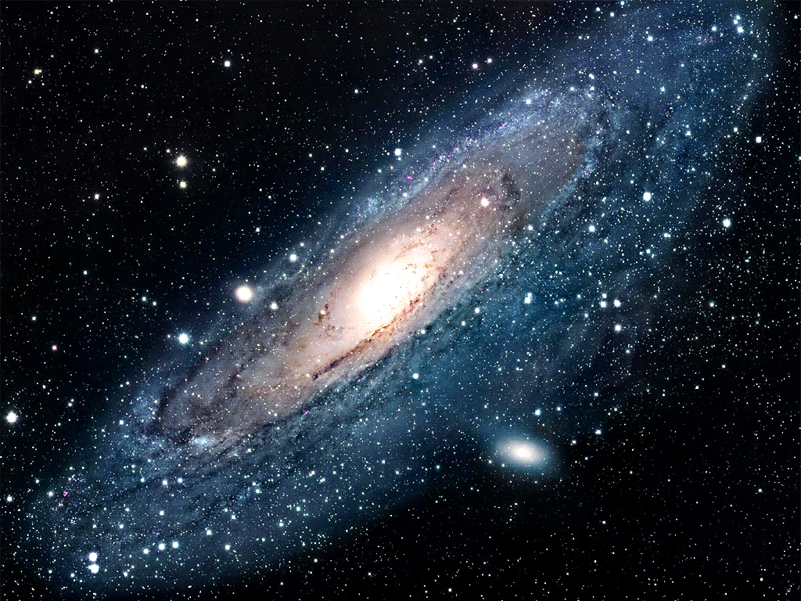
The Sun and all the stars we see in the night sky belong to a great group of stars that travel through space together.
Such a group is called a Galaxy.

